Slide 1
CAP770

Slide 2
Graph traversals
Graph traversal is technique used for searching a vertex in a graph.
A graph traversal finds the edges to be used in the search process without creating loops that means using graph traversal we visit all vertices of graph without getting into looping path.
There are two graph traversal techniques and they are as follows...
DFS (Depth First Search)- use stack
BFS (Breadth First Search)- use queue

Slide 3
DFS Algorithm:
Step1:Initialize all nodes to the ready state (status=1)
Step2:Push starting node into stack and change status to waiting state(status=2)
Step3:Loop
Repeat step 4 and 5 until stack is empty
Step4:Pop the node N of stack. Process N and change its status to the processed state(status=3).
Step5:Push onto stacks all neighbors of N that are still in ready state and change their status to the waiting state.
End of loop step3
Step6:Exit

Slide 4
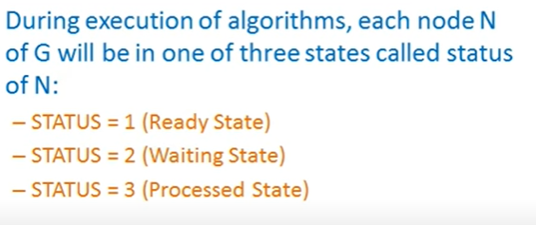
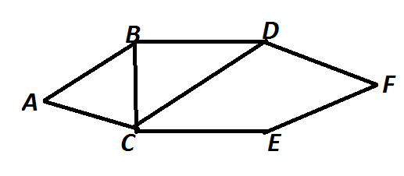
In Graph we can start from any node

Slide 5
Step 1:-
Step2:- Use Stack
1
1
A
1
1
1
1
1
1
Step 3:-
1
2
1
1

Slide 6
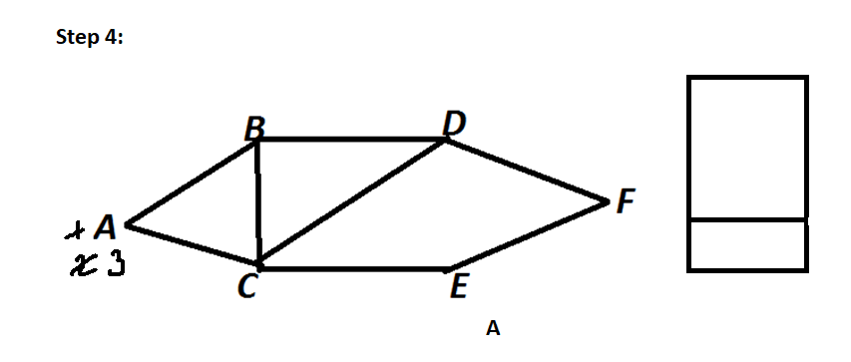
1
1
1
1
1

Slide 7
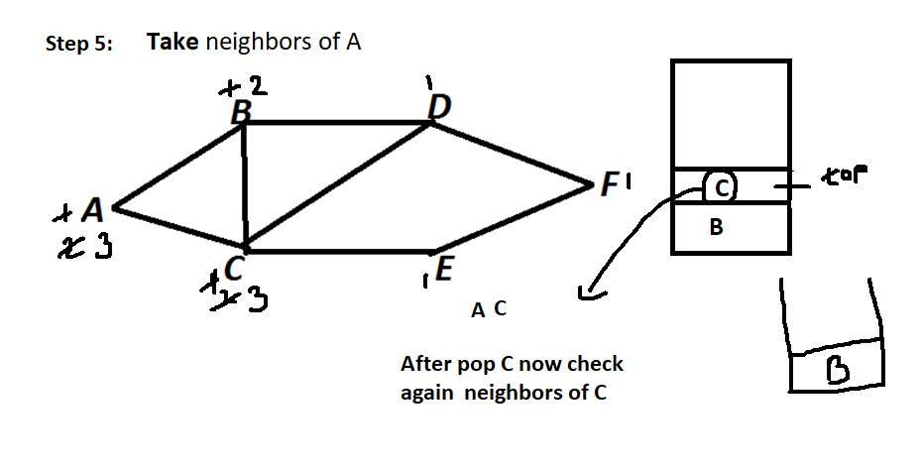

Slide 8
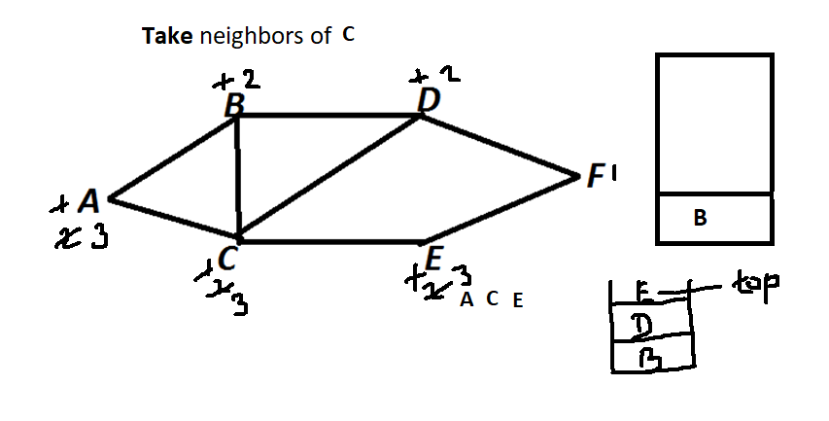

Slide 9
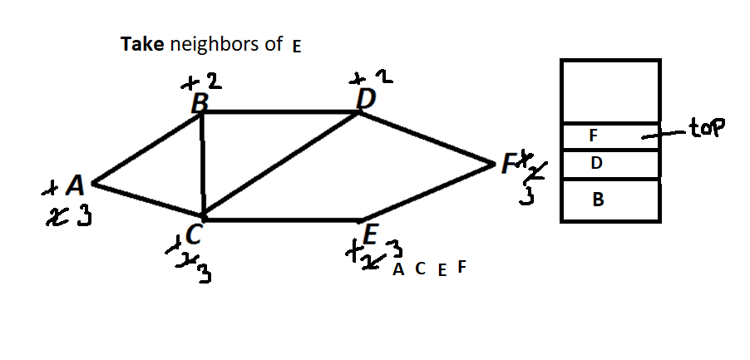

Slide 10
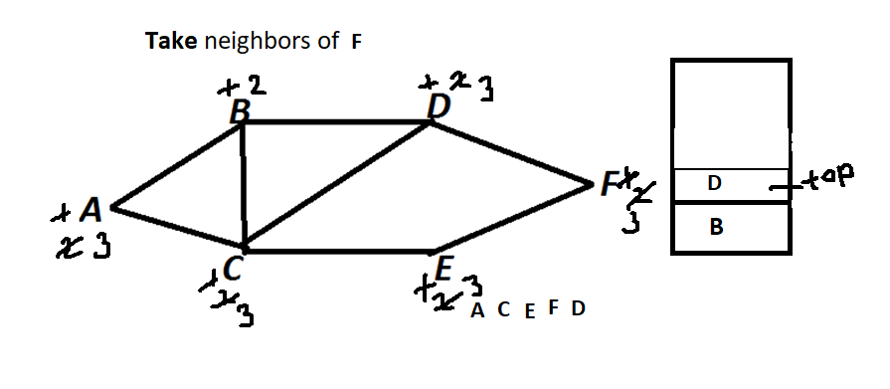

Slide 11
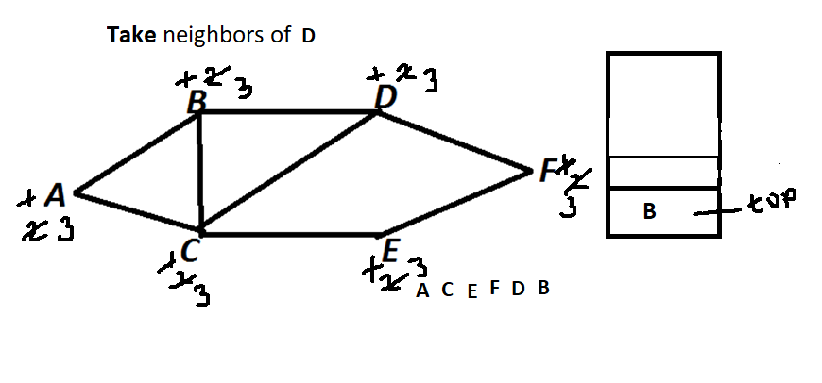

Slide 12
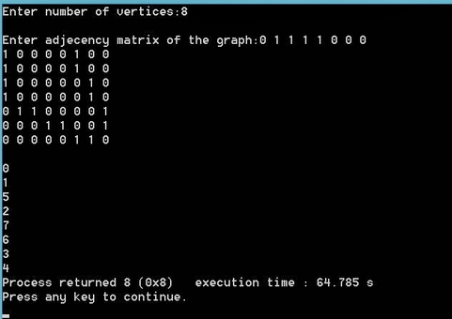
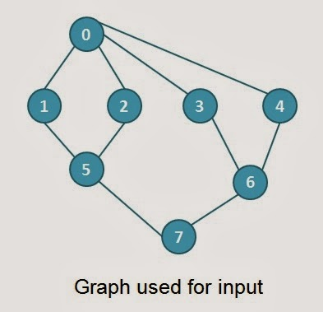
Write Program for DFS using Adjacency Matrix

Slide 16
BFS Algorithm:
Step1:Initialize all nodes to the ready state (status=1)
Step2:Push starting node into queue and change status to waiting state(status=2)
Step3:Loop
Repeat step 4 and 5 until queue is empty
Step4:Remove the front node N of queue. Process N and change its status to the processed state(status=3).
Step5:Add to the rear of queue all neighbors of N that are in ready state and change their status to the waiting state.
End of loop step3
Step6:Exit

Slide 17
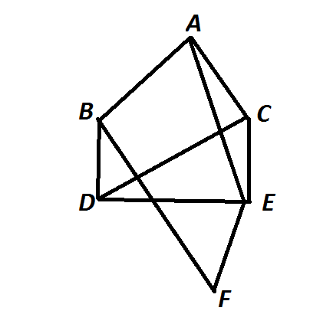

Slide 18
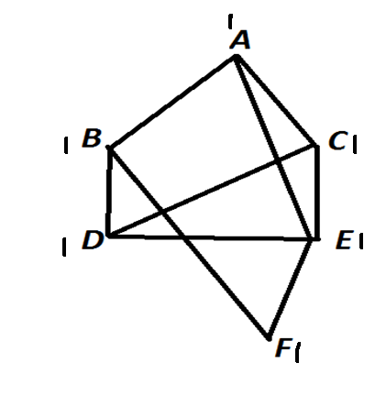

Slide 19
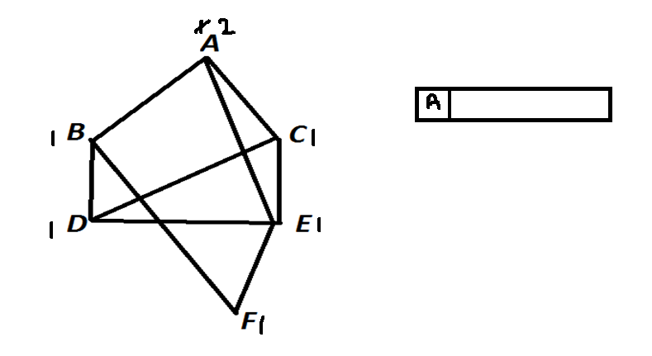

Slide 20
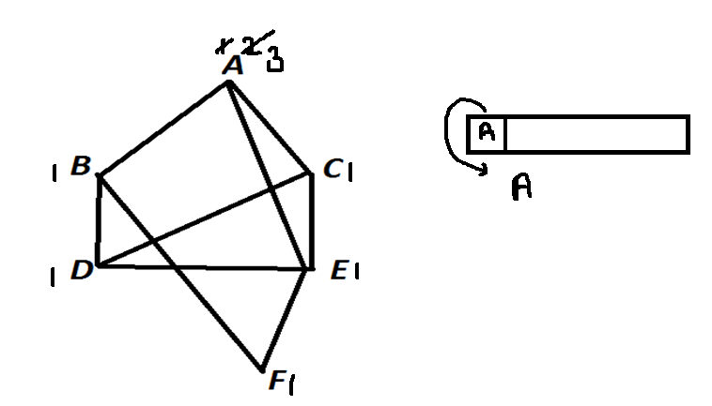
Step-4

Slide 21
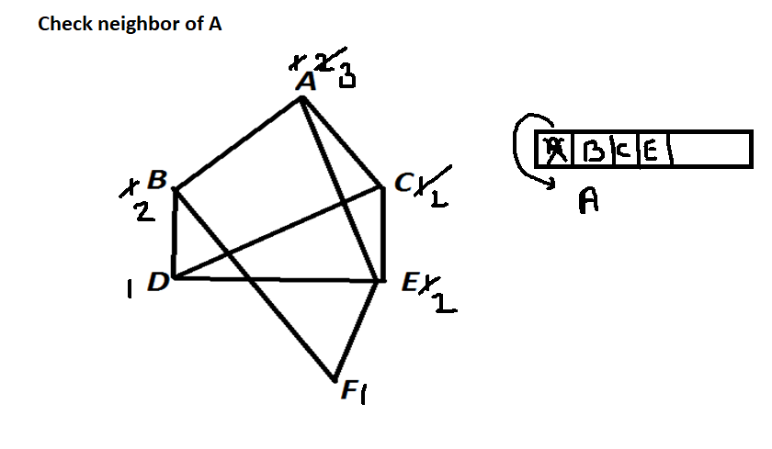
Step 5

Slide 22
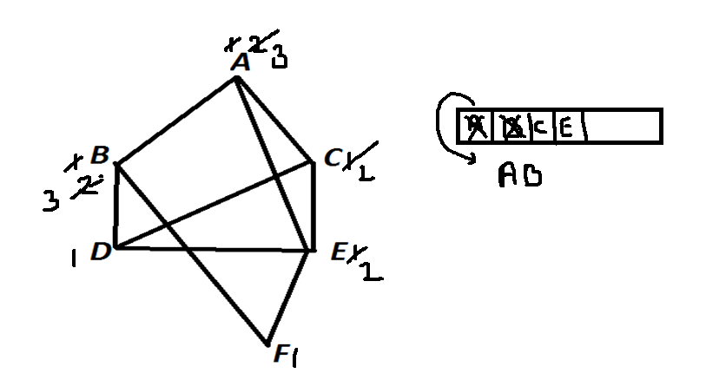

Slide 23
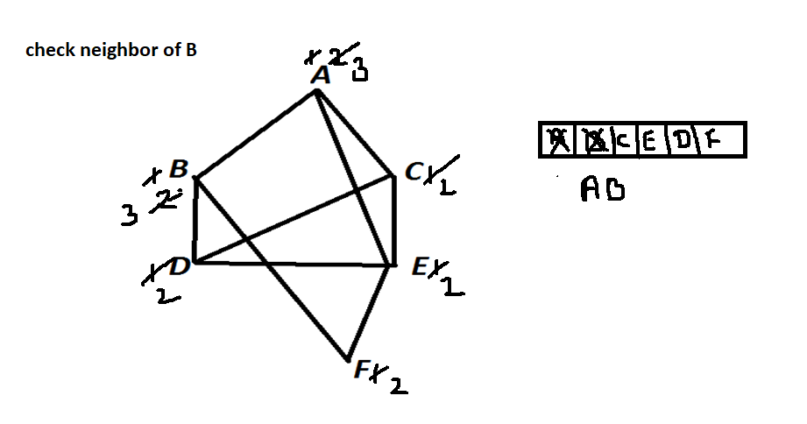

Slide 24
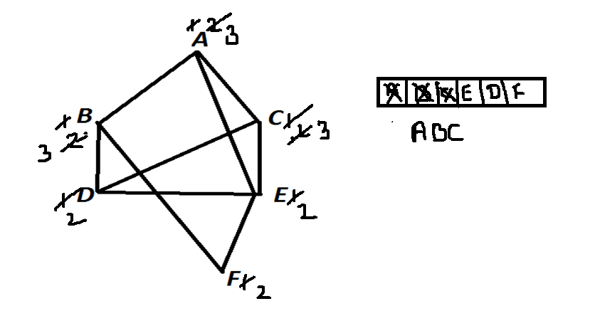

Slide 25
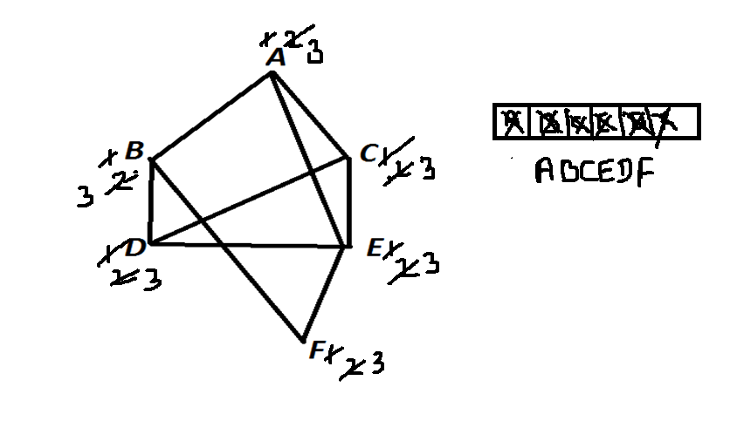

Slide 26

Write Program for BFS using Queue

